Slide 1

Supply Chain Analytics & Inventory Optimization
An end-to-end project analyzing whether stock levels meet customer demand — from data preparation in SQL Server and MySQL, through DAX-powered KPIs in Power BI, to a published production report.

Slide 2

PROJECT OVERVIEW
What We're Solving
The Problem
Does the business keep enough stock to meet demand? The dataset covers 20 products — Phone Case, Smartwatch, Air Purifier, VR Headset, Laptop Stand — across multiple dates.
The Goal
Find where supply falls short of demand and calculate what each shortage is worth.
The Workflow
Four stages: SQL Server (data prep), Power BI + DAX (KPIs), MySQL (migration), Power BI (reconnect & publish).

Slide 3
DATASET
Dataset Summary
Inventory Table
Products Table
Order Date, Product ID, Availability, Demand
Product ID, Product Name, Unit Price — 20 products
Joined Table
Production Data
new_table with all columns merged via left join on Product ID
1,043 rows imported from SQL Server into MySQL
Test data started as an Excel file. Production data was imported into SQL Server, then migrated to MySQL for the final report.

Slide 4

STAGE 1
Data Preparation in SQL Server
Explore Tables
Check Distincts
Save As new_table
Left Join
In the test environment, the two tables were joined on Product ID so each inventory row received its product name and unit price, then saved as new_table. The same process was repeated in production after data cleaning.

Slide 5


STAGE 1 — PRODUCTION
Production Environment Fixes
The Issue
Production data included Product IDs 21 and 22, but the Products table only had 20 entries — leaving unmatched rows with blank names and prices.
The Fix
Used UPDATE to remap: 21 → 7 and 22 → 11, then rebuilt new_table with the corrected join.
If the join ran first, IDs 21 and 22 would have empty names and prices — cleaning must happen before the join.

Slide 6
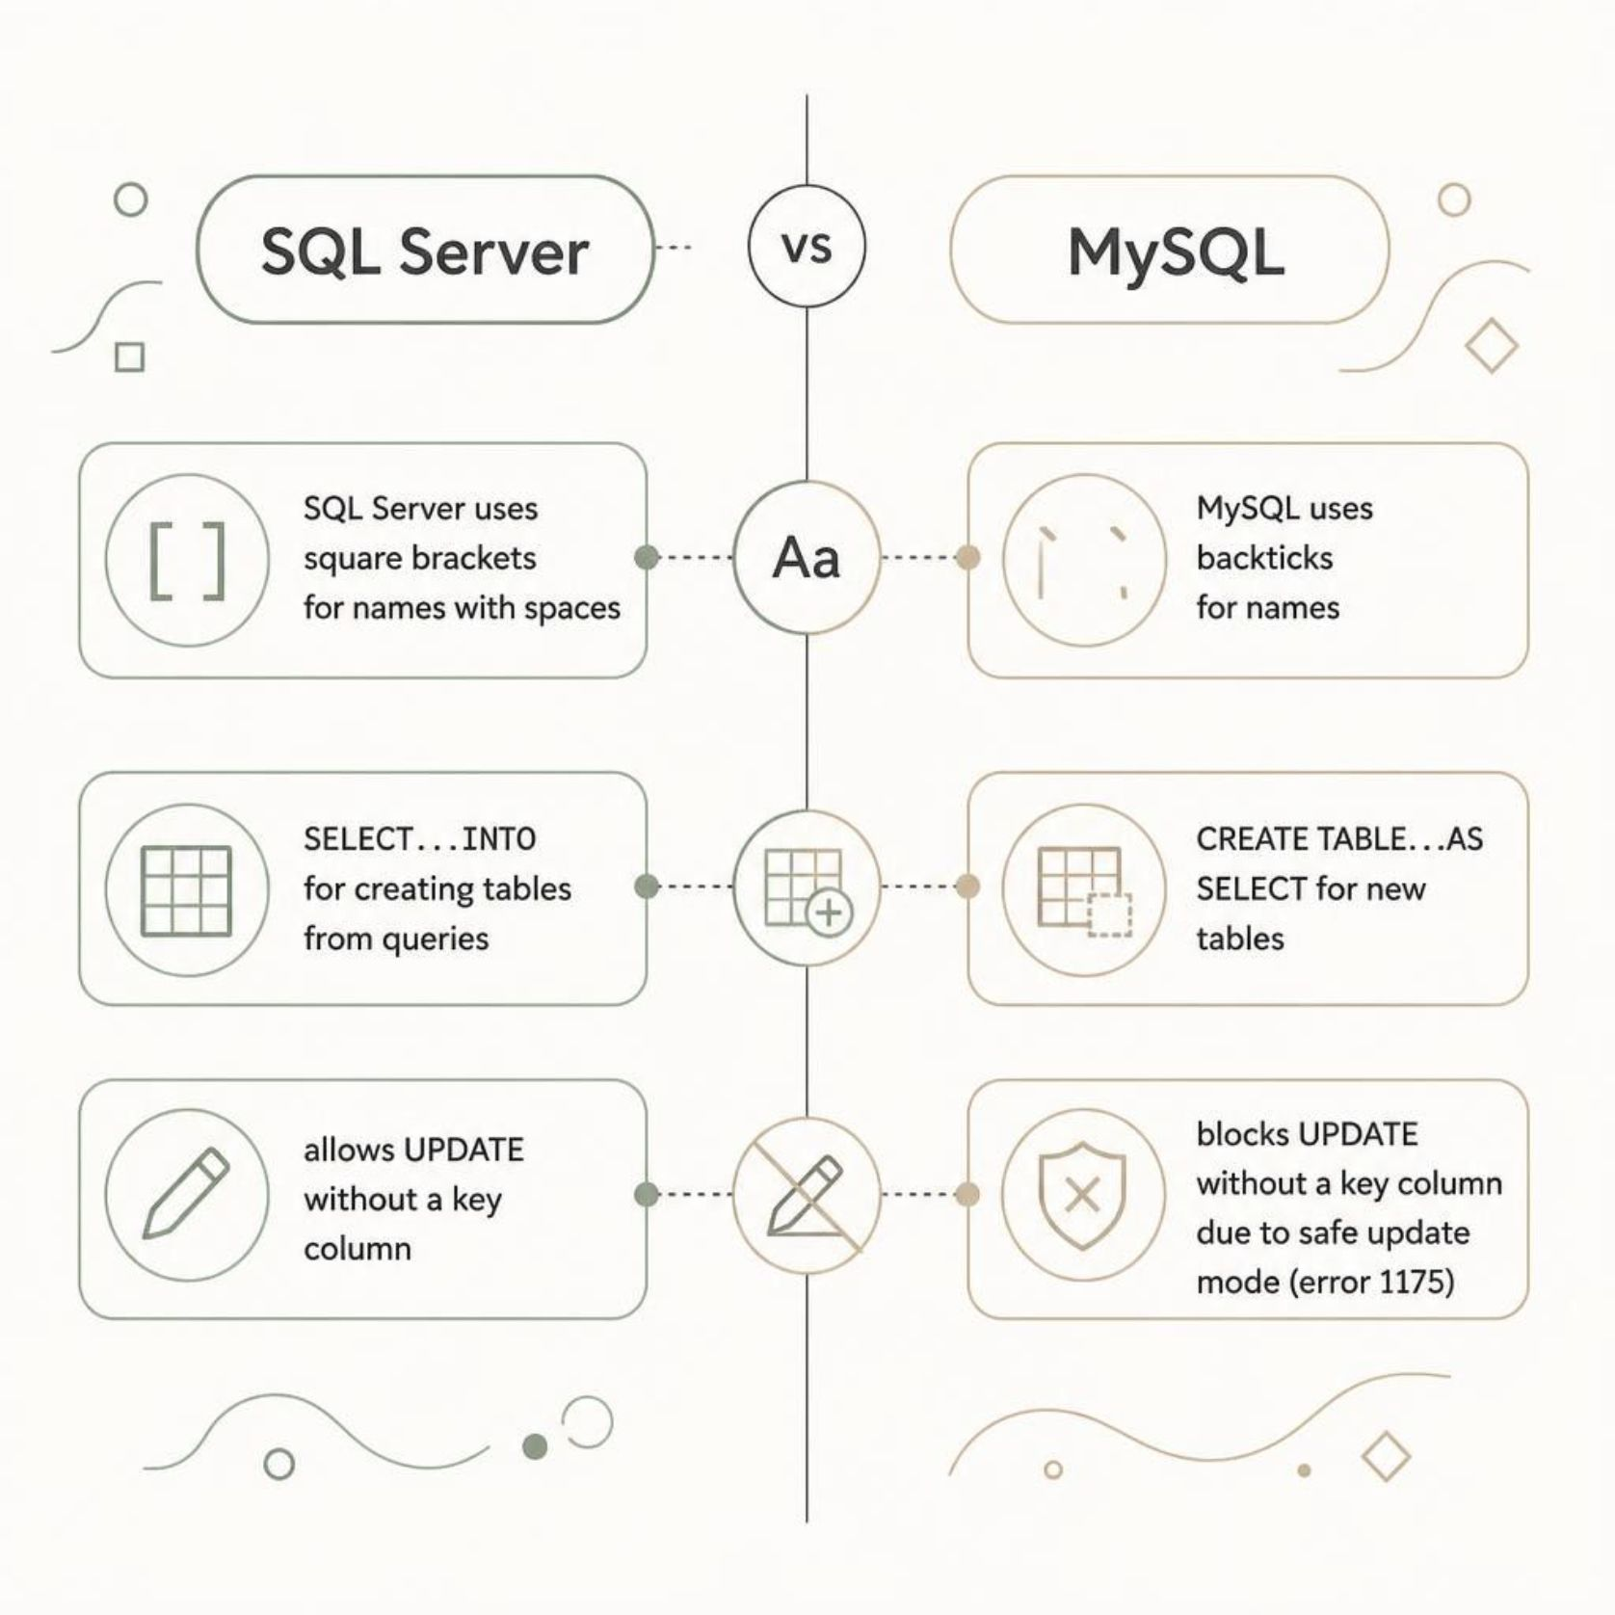
STAGE 2
Migrating Data to MySQL
Key Syntax Differences
Name quoting: [square brackets] → `backticks`
Create table from query: SELECT...INTO → CREATE TABLE...AS SELECT
UPDATE without key: Allowed in SQL Server; blocked by safe update mode in MySQL (error 1175)
Additional fixes included wrong quotes, misplaced semicolons, and table names requiring backticks.

Slide 7
STAGE 3
DAX Measures in Power BI
A calculated column Loss/Profit = Availability − Demand underpins all measures. Negative = shortage; positive = surplus.
Measure | What It Calculates
Total Availability / Demand | Sum of each field
Total Supply Shortage | Demand − Availability
Avg Availability / Demand Per Day | Total ÷ distinct order dates
Total Loss | Shortage rows × unit price (positive)
Total Profit | Surplus rows × unit price
Average Loss Per Day | Total Loss ÷ distinct order dates

Slide 8
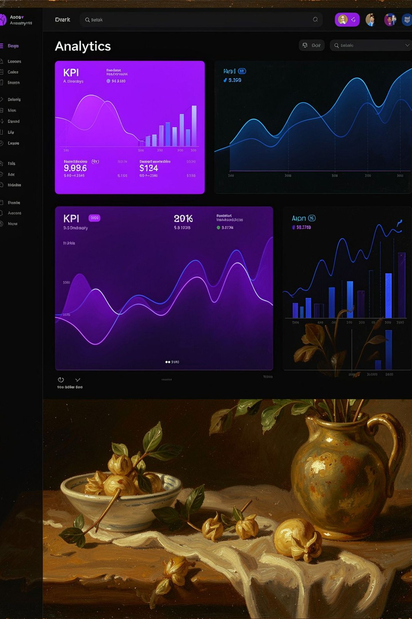
DASHBOARD — PAGE 1
Demand vs. Availability
48.65
24.70
Avg Demand/Day
Avg Availability/Day
61K
Total Supply Shortage
Average daily availability is only ~51% of daily demand. The business could not meet demand across the test period, accumulating a 61K unit shortage.

Slide 9
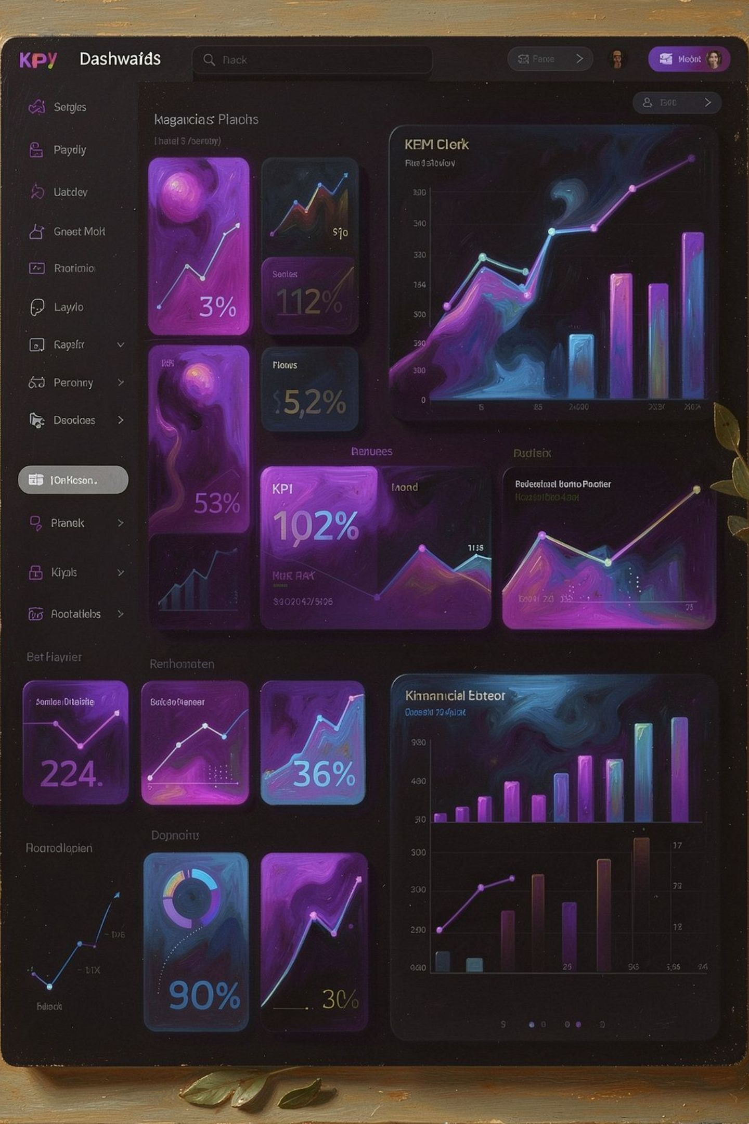
DASHBOARD — PAGE 2
Shortage vs. Surplus Value
8M
301K
Total Loss
Total Profit
Value of stock shortages
Value of surplus stock
2.97K
Avg Daily Loss
Shortage cost per day
Shortage value is ~27× the surplus value — stock-outs are the primary business risk, not overstock. On average, the shortage costs ~2.97K per day.

Slide 10



KEY TAKEAWAYS
What We Learned
Supply Trails Demand
Daily availability was ~51% of demand, with a 61K unit shortage in test data.
Shortage Is the Main Risk
Shortage value is ~27× surplus — stock-outs cost far more than overstock.
Data Cleaning Is Non-Negotiable
Unmatched product IDs (21, 22) were fixed before the join to prevent blank names and prices.
Reports Can Move — With Care
Switching to MySQL required fixing syntax, column name casing, and data types.

